Slide 1
GenAI Chat
Some real talk about GenAI use in education

Slide 2
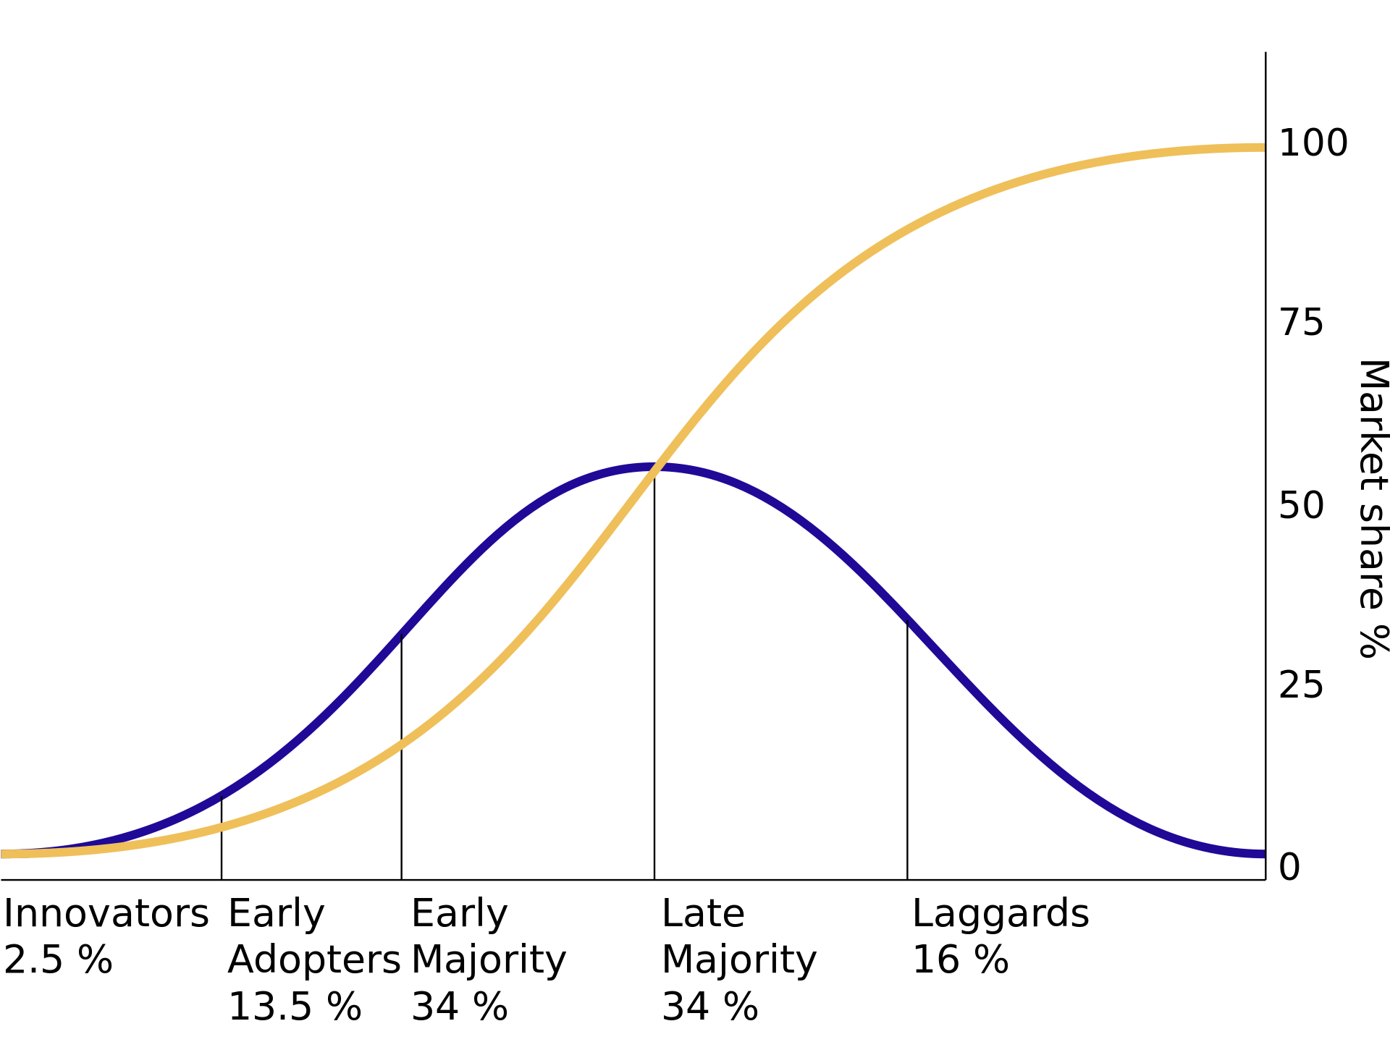

Educator’s positionality
My research focuses on the intersections of data, technology and their societal impacts, with a particular interest in human-computer / human-AI interaction and how big data and algorithms impact our everyday lives.
Diffusion of innovations theory
Notes:
Need to think about my positionality in this topic given that my teaching philosophy is deeply guided by my bias towards new technology and AI (I am definitely in the early adopter according to the Diffusion of Innovation Theory).
LLMs is not great in systems-thinking (a big part of my teaching philosophy) – you need to prompt it to think of the systemic-level evaluation. Unfortunately, I feel like students will only think of systems-level thinking if they are already familiar with this. See this following exchange I had with ChatGPT in regards to the topic of VR therapy among young people with PTSD: https://chatgpt.com/share/e475f099-fed0-429e-af58-5ff50ffea74a

Slide 3
High human contribution
High human contribution but low AI contribution
High human contribution and high AI contribution
Help me brainstorm,
plan or polish
Create it
with me
Low
AI contribution
High
AI contribution
Academic integrity issues???
Create it
for me
Low human contribution and low AI contribution
Low human contribution but high AI contribution
Low human contribution
Notes:
Go through each quadrant but also talk about how it is difficult to operationalise contribution (e.g., what does contribution means – it is to do with effort)? How low is too low? How high is too high?

Slide 4
Critical and ethical use of GenAI
Understand the limitations of AI
Observe that AI writing is robotic
Give AI clear objectives that help in generating ideas and outlining structures rather than writing entire assessments.
Break down the tasks into smaller steps
Be transparent about your use of AI and give proper attribution
Look at guidelines on how to prompt your chosen GenAI technology
Do your research properly and wisely. In other words, use AI as a supplement not a replacement for your own critical thinking and analysis.

Slide 5




Critical and ethical use of GenAI
OR
OR

Slide 6
Critical and ethical use of GenAI
Discussion on GenAI use in your everyday life.
Discussion on GenAI use and how you think it will impact psychological practice.

